Slide 1

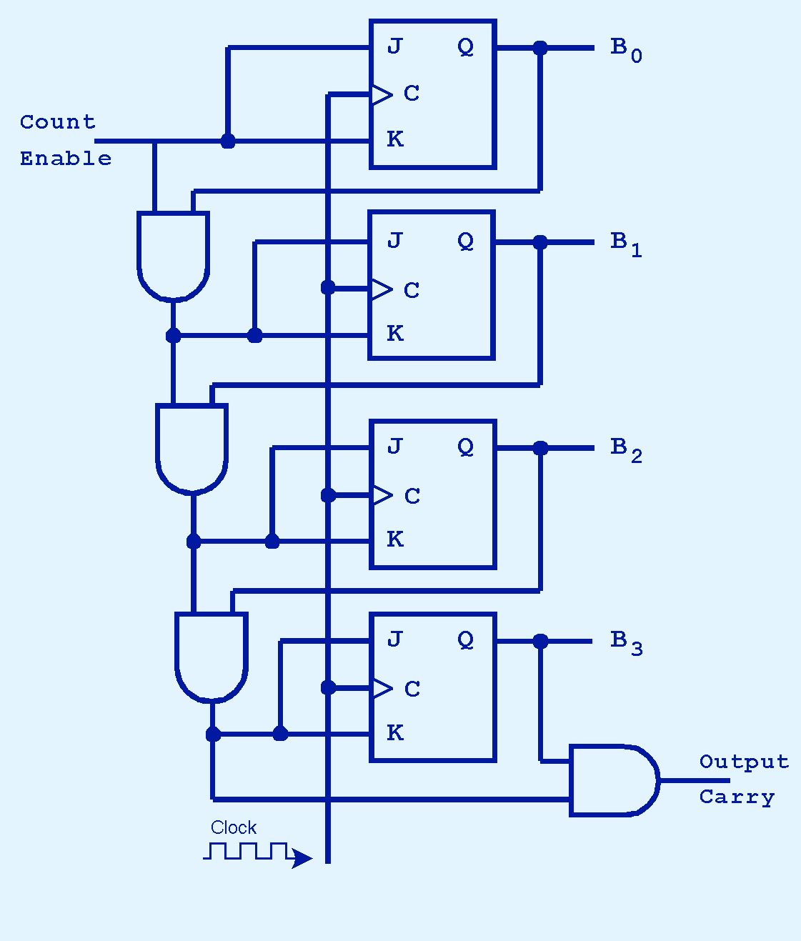
3.6 Counter
63
A binary counter is another a sequential circuit. Among other things, it can be used to keep track of how many cycles the clock has ticked.
This is a 4-bit counter. It represents the 4-bit binary number B₃B₂B₁B₀.
It counts B’0000’, B’0001’, etc. Note that the high-order bits are at the bottom of the diagram.
After it hits B’1111’, it returns to B’0000’. Now it can count forever..

Slide 2
3.6 Counter
63a
When the count enable line is on, a pulse is produced every time the clock ticks.
The input is sampled on the rising clock edge and the output is stable at the time of the falling clock edge.

Slide 3
3.6 Counter
63b
The count enable line feeds into both J and K of the top flipflop.
When J=1 and K=1 at a clock tick, the JK flipflop changes state, i.e., the output is the inverse of the previous output. Assuming the original value of B₀ was 0, it is now 1. The value of B₀ is also sent to the AND gate below it. So B₃B₂B₁B₀ now equals B’0001’.

Slide 4
3.6 Counter
63c
When will B₁ flip to 1?
On the next clock pulse, the J=1, K=1 input causes B₀ to flip from 1 to 0. At the same time, the 1 from B₀ is AND-ed with the 1 from the count enable line and sent to B₁, causing it to flip from 0 to 1. So B₃B₂B₁B₀ now equals B’0010’.

Slide 5
3.6 Counter
63d
When will B₂ flip to 1?
Its input comes from an AND gate. One of the inputs is B₁, and the other is the AND of the clock enable line and B₀.
The clock enable is 1 during counting, so the relevant part is B₀.
In other words, B₂ will become 1 when B₁ = 1 and B₀ = 1, as we expect from a counter. So the value after B’0010’ is B’0011’, and the following value is B’0100’.

Slide 6
3.6 Counter
63e
When B₃B₂B₁B₀ = B’1111’, the the largest value that the counter can hold has been reached.
The next cycle will reset B₃B₂B₁B₀ to B’0000’ (i.e., all four bits will flip).
You can use a combinational circuit to add 1 to a number, but you need a sequential circuit, i.e., one that knows its previous value, to implement a counter.

